Slide 1
Designing Reusable Components with Re-frame and Atomic Design
Mark Nutter

Slide 2
Overview
Foundations
Atomic Design
Re-frame
Re-usable Components

Slide 3


Slide 4
What is Atomic Design?
Build small (“atomic”) components
Build larger components by composing smaller ones
Atoms
Molecules
Organisms
Templates
Pages

Slide 5
AD vs FP
Function in the design sense, not the programming sense
Look & Feel
Input cues
Behavior
Composition in the design sense, not the programming sense
Does the combination add clarity or confusion?
Are the combinations consistent?
Notes:
Designer waterfall -> over the wall -> dev starts grabbing divs.

Slide 6
What to learn from Atomic Design
Plan ahead: build components that are intended to combine with other components
Think about components from a UX perspective (not just divs)
Better yet, work with designer to implement atoms, molecules, etc., in tandem
Dig more: atomicdesign.bradfrost.com

Slide 7

Notes:
Here’s a VERY quick overview

Slide 8




Reagent
ReactJS
ClojureScript
Notes:
React: “reduce re-renders”; CLJS: FP; Reagent: lets you write component fns instead of React classes; Re-frame: (following slides)

Slide 9
app-db
(updates)
subscriptions
event
handler
events
component
Notes:
App-db: HOLDS the state – renderer: DISPLAYS the state– event-handler: UPDATES the state, “controller”.

Slide 10
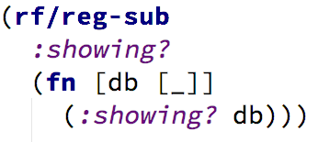
Simple Subscription

Slide 11
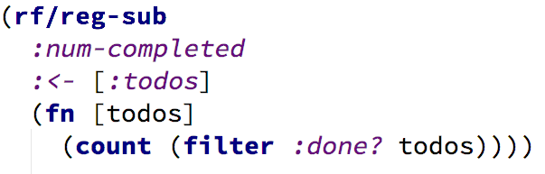
Subscription with input

Slide 12
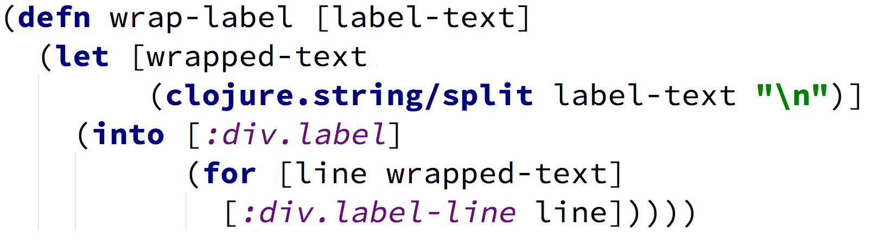
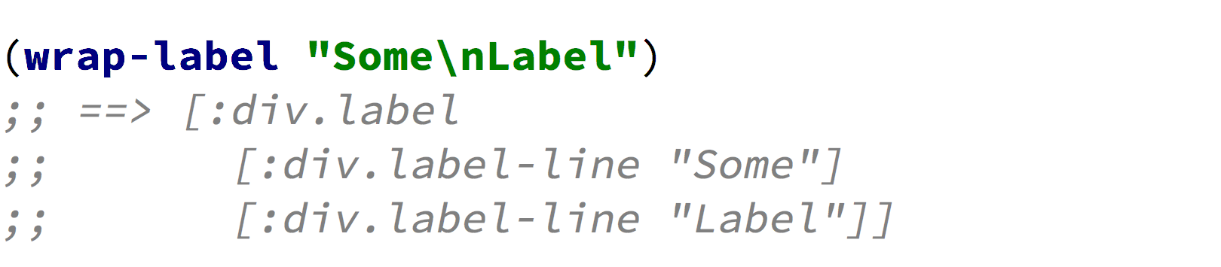
Simple (Form 1) component

Slide 13
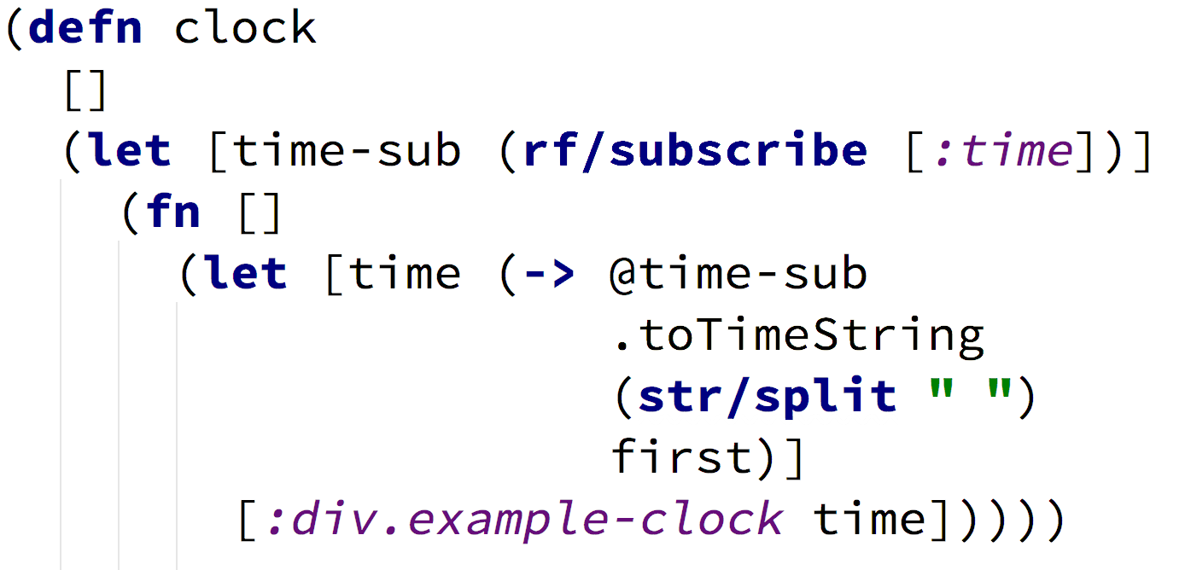
Form 2 Component
Notes:
There’s also a Form 3 component with direct access to React lifecycle methods. (Where does the terminology come from?) (Use different example with no local state).

Slide 14
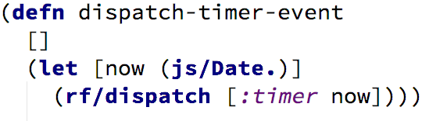
Event Dispatch

Slide 15
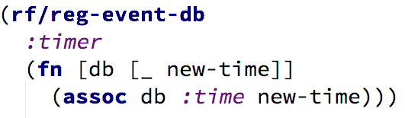
Simple Event Handler (reg-event-db)
Notes:
Atomic succession model.

Slide 16

Notes:
End of tour / 3 Main Ideas

Slide 17
150

Slide 18
150
(See GitHub repo)

Slide 19
1
Atomic Design Catalog

Slide 20
Atomic Design Catalog
Lists components
Demonstrates components
Documents components
Tests components
Notes:
Do demo here.

Slide 21

Demo

Slide 22
2
Self-Aware Components

Slide 23
Form Field Hook-up (per field)
app-db
:init event
{:forms {:user {:name _
:username _
:pw _
:confirm _}
:login {:username _
:pw _}
... }
}
:subscribe
x 4
:on-change
:on-foo…

Slide 24
Making components “Self Aware”
:path [:forms :user :pw]
(forms/text-field {:subscribe-to-data [:foo]
:type :password
:extra-classes :password}

Slide 25
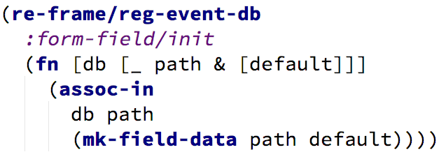
Initialization Event handler

Slide 26


Slide 27
Self-aware components
Know the path to their own component data
Self-initializing
Built-in handlers for common events (on-change etc)
(Still better to build subscriptions manually)
More efficient
Easier debugging
Notes:
Show this before the code examples; explain trade-offs first, draw a picture of what the path is (needs more pictures)

Slide 28
3
Subscription-Based Validation

Slide 29
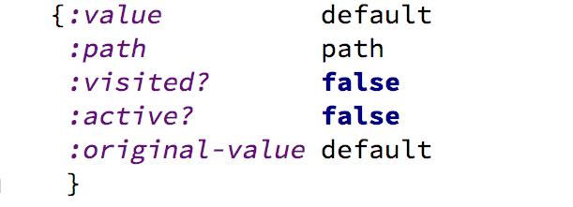
Form field component data
Notes:
EXAMPLE: This is what the component data looks like.

Slide 30
Built-in events
:on-change
Set :value ==> new value
:on-focus
Set :visited? ==> true
Set :active? ==> true
:on-blur
Set :active? ==> false

Slide 31
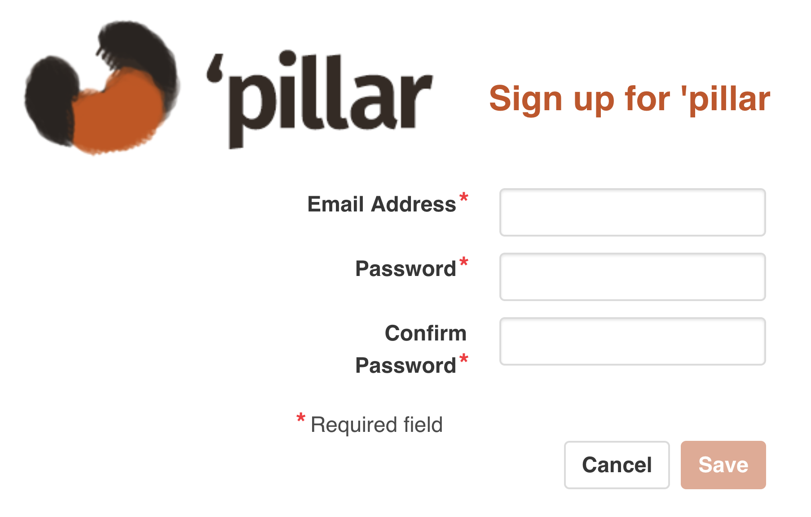

Slide 32
Subscription Dataflow
app-db
email
{:value
:visited?
:active?}
forms
password
{:value
:visited?
:active?}
user
confirm
{:value
:visited?
:active?}
Notes:
But HEY! The output from one subscription can be the input to another

Slide 33
Subscribe to errors
email
{:value
:visited?
:active?}
errors
nil
[messages]
Notes:
If no errors or too soon to check, return nil, else return errors

Slide 34
Validation logic
if !visited? ==> nil
if active? ==> nil
if value is empty or whitespace
error: “Email is required.”
if not a valid email format
warning: “Unrecognized email format.”

Slide 35
Subscribe to password errors
password
confirm
errors
nil
[messages]
Notes:
If no errors or too soon to check, return nil, else return errors

Slide 36
Complex validation logic
if active? or if !visited? ==> nil
if password value is empty/whitespace
error: “Password is required.”
If confirm is visited? & !active? & not= password
Error: “Password and confirm must match”
(check for length, complexity, etc…)

Slide 37
Disable Submit button
email-
errors
password-
errors
confirm-
errors
disabled?
Notes:
Code example less helpful, maybe a diagram would be better. Flow diagram. Less code more pictures.

Slide 38
3 Main Ideas
AD Catalog
Self-aware components
Subscription-based field verification
Notes:
Make more visual headline-y slides introducing new section. Road-map-y presentation, more “You are here” maps.

Slide 39
References
http://atomicdesign.bradfrost.com/
https://github.com/Day8/re-frame
https://reagent-project.github.io/
https://reactjs.org/
https://bulma.io
https://github.com/manutter51/woolybear

